Slide 1

Two Class Classification of Paediatric Heart Sound Signals using Short Term Fourier Transform Features
Team Members:
121CS0195 JAYESH NAYAK
121CS0196 ASHISH PADHY
121CS0197 ARMAN PAIKARAY
121CS0198 ANIMESH PANDA

Slide 2
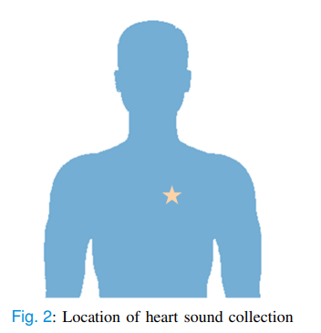
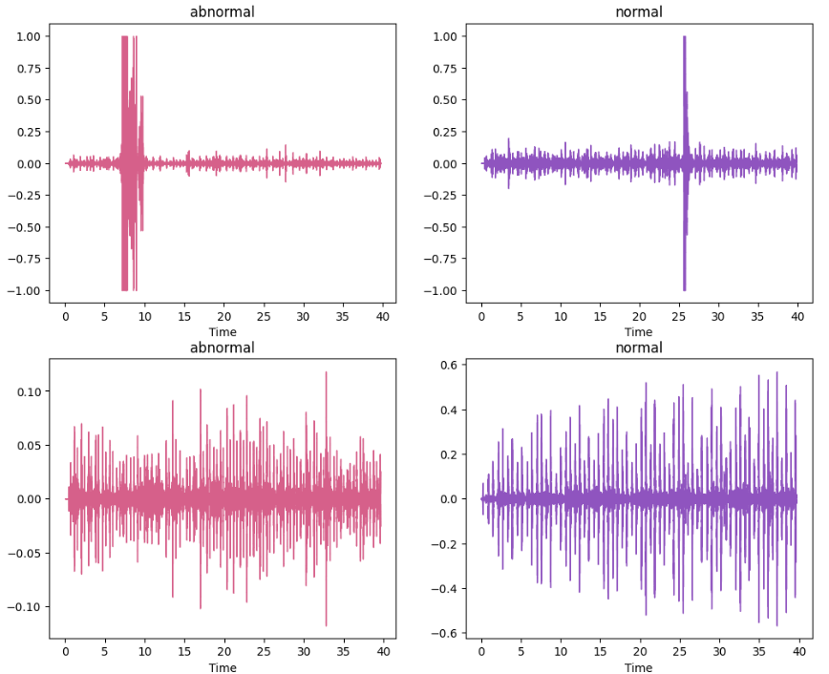

Heart Sounds: A Window into Heart Health
Our hearts beat constantly, but they also communicate with us through subtle sounds. These sounds, known as heart sounds, are produced by the valves closing and blood flowing through the chambers of the heart.
By listening to these sounds with a stethoscope, doctors can gain valuable insights into the health of the heart. Each heart sound has a specific characteristic sound and timing within the heartbeat cycle.
Abnormal heart sounds, such as murmurs, can indicate potential problems like valve defects, narrowed blood vessels, or other issues.
This makes analyzing heart sounds a crucial tool in diagnosing heart conditions, especially congenital heart disease (CHD), the most common birth defect in children.
Early diagnosis and treatment are crucial for a good prognosis with CHD.
Current screening methods like Prenatal screening, Cardiac auscultation (listening with a stethoscope) and pulse oximetry have limitations and miss some cases.

Slide 3

Project Motivation & Objective
Although useful, traditional auscultation has drawbacks. The subjectivity and experience level of individual physicians can result in inconsistent interpretation when relying on their knowledge. Furthermore, diagnostic effectiveness may be impacted by the traditional analysis's time-consuming nature.
Furthermore, in some hospital settings, access to pediatric cardiologists with the necessary skills may be restricted.
A strong remedy for these issues is provided by machine learning. Through the use of automated classification systems, we may be able to:
1. Enhanced Objectivity: Large datasets can be used to train machine learning models, which lessens the impact of human bias and produces diagnoses that are more consistent.
2. Enhanced Efficiency: With automated systems, heart sounds can be quickly analyzed, which could streamline diagnostic operations and shorten turnaround times.
3. Enhanced Accessibility: Machine learning-based solutions might be implemented in environments with limited resources, increasing the availability of precise pediatric heart sound analysis and possibly enabling the early identification of cardiac problems.

Slide 4
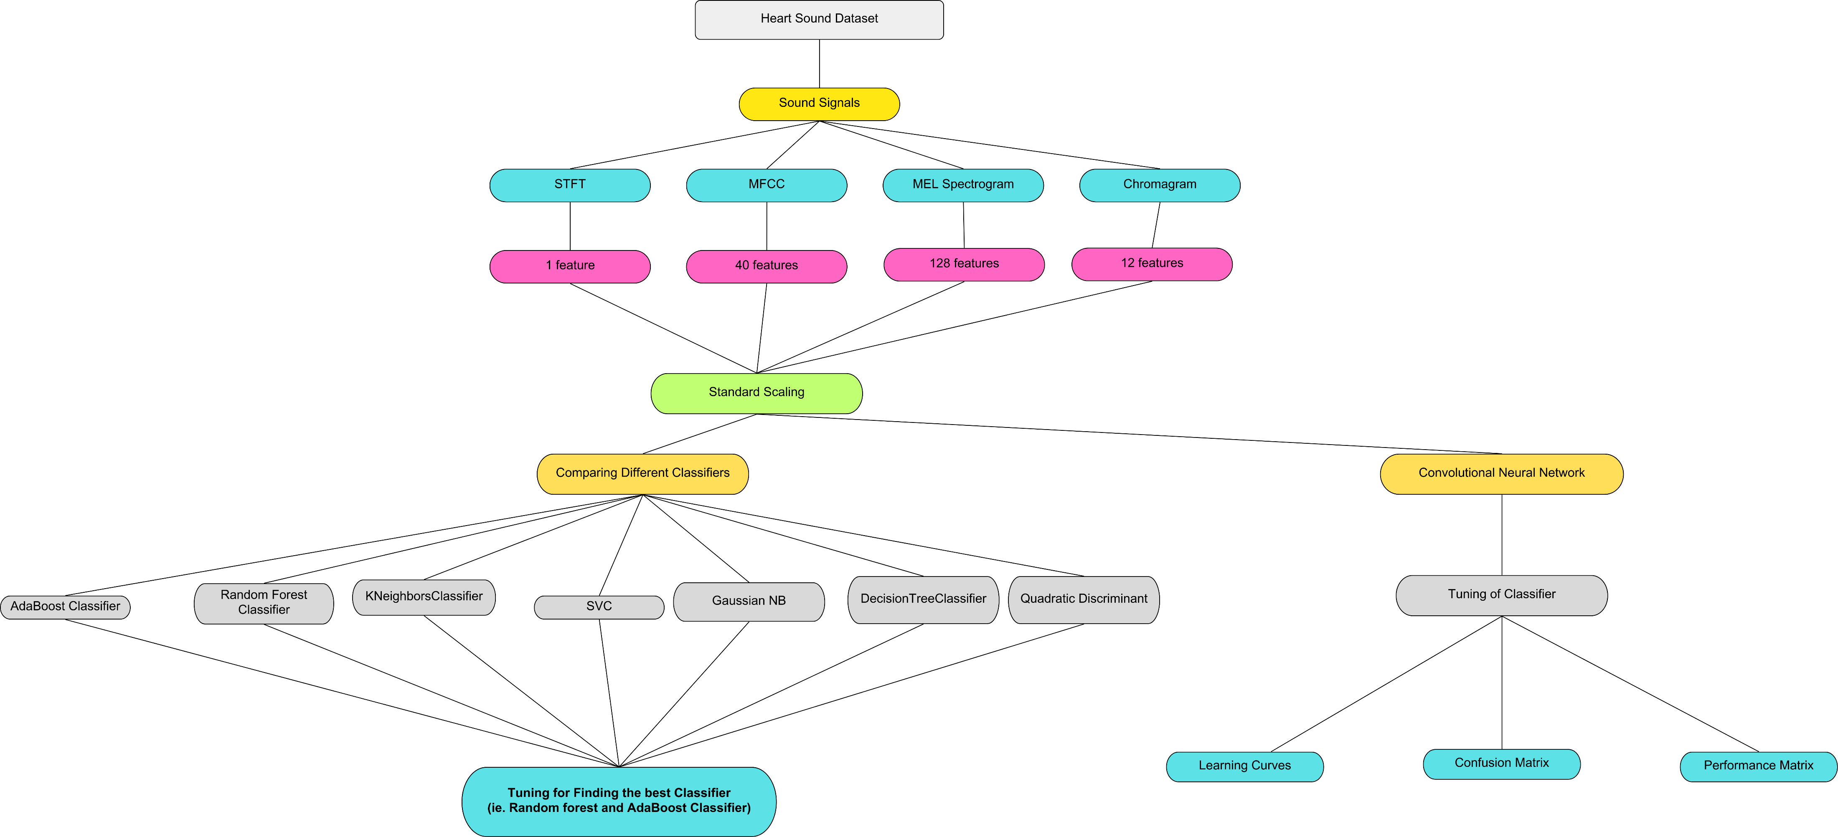
Proposed method/algorithm

Slide 5
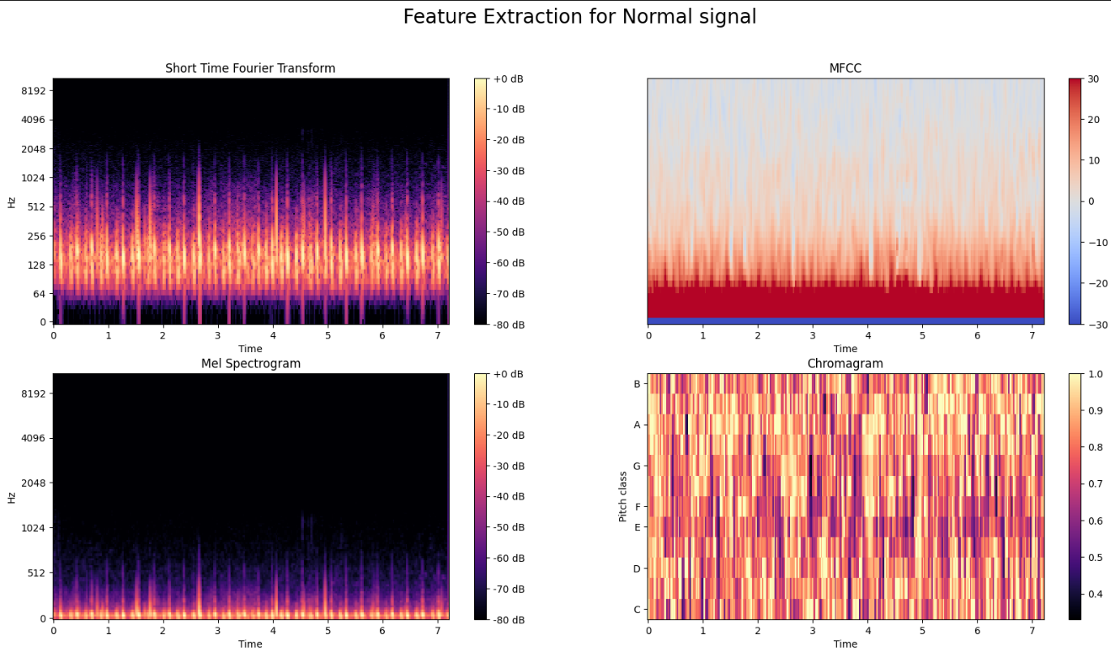
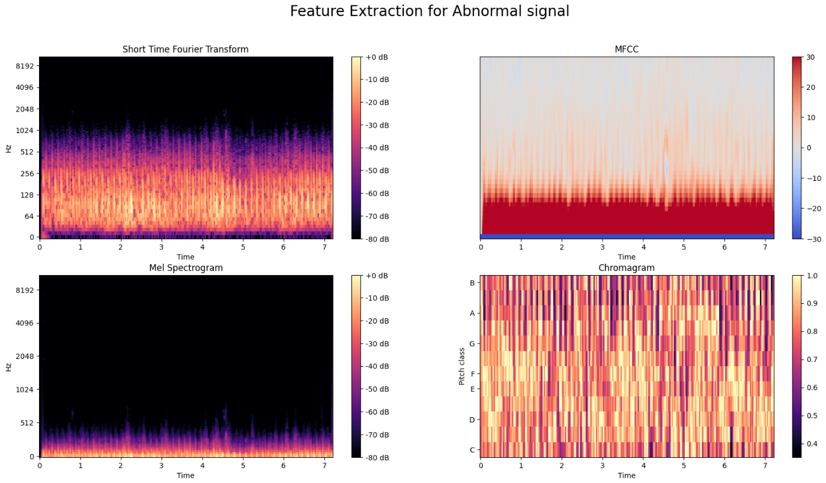
Proposed method/algorithm
Load the Data:
Read and Extract labels of the audio files from the data directory using soundfile.
Iterate over Files:
Iterate over all the files in the directory, considering the two subdirectories representing different labels (normal and abnormal heart sounds).
Showcase Audio Files:
Display or visualize some of the audio files to gain insight into the data.
Compare Features:
Compare features extracted from abnormal and normal heart signals to understand differences in their characteristics.
Extract Features:
Extract 128 features from Mel spectrogram, 12 features from Chromagram, 40 features from MFCC, and 1 feature from STFT.

Slide 6
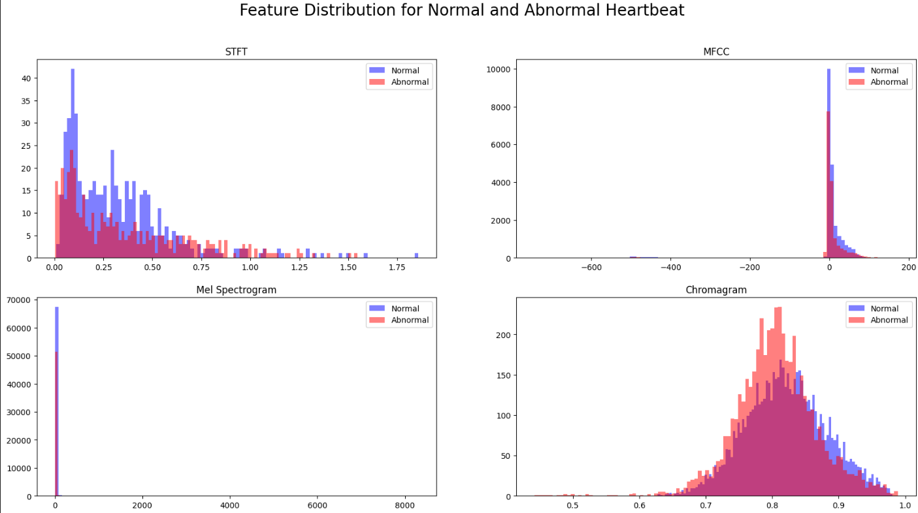
Proposed method/algorithm
Short-Time Fourier Transform (STFT): Captures the time-frequency representation of the heart sound.
Mel-frequency cepstral coefficients (MFCC): Mimics human auditory perception, focusing on important frequencies for heart sound analysis.
Mel Spectrogram: Provides a visual representation of the frequency content over time.
Chromagram: Captures the tonal characteristics of the heart sound.
Preprocessing:
Get parameters (mean, standard deviation, minimum, maximum) for the extracted features (STFT, MFCC, Mel Spectrogram, Chromagram).
Scale the features using StandardScaler and MinMaxScaler to standardize their ranges for better model performance.
7. Using Classifiers
This approach involves comparing the performance of different machine learning classifiers on the preprocessed data. Additionally, we utilised Grid Search to optimise the hyperparameters of these classifiers for improved performance.
We used the following classifiers:
1. RandomForestClassifier
2. SVC
3. AdaBoostClassifier
4. DecisionTreeClassifier
5. KNeighborsClassifier
6. SVC RBF kernel
7. QuadraticDiscriminantAnalysis
8. GaussianNB

Slide 7
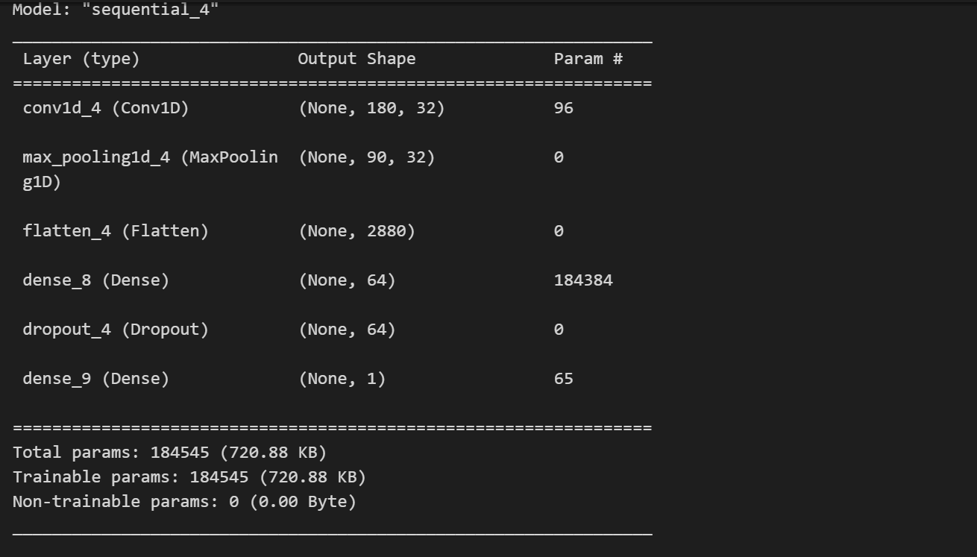
Using a Convolutional Neural Network
Conv1D Layer: Extracts local features using a variable number of filters followed by a ReLU activation.
MaxPooling1D Layer: Downsamples the data while preserving important features.
Flatten Layer: Reshapes the output into a 1D vector for dense layers.
Dense Layer 1: Introduces non-linearity with ReLU activation and learns higher-level features.
Dropout Layer: Prevents overfitting.
Output Layer: Predicts the probability of a heart sound belonging to the abnormal class (sigmoid activation).
Hyperparameter tuning optimises the number of filters and dense layer units for best performance.

Slide 8
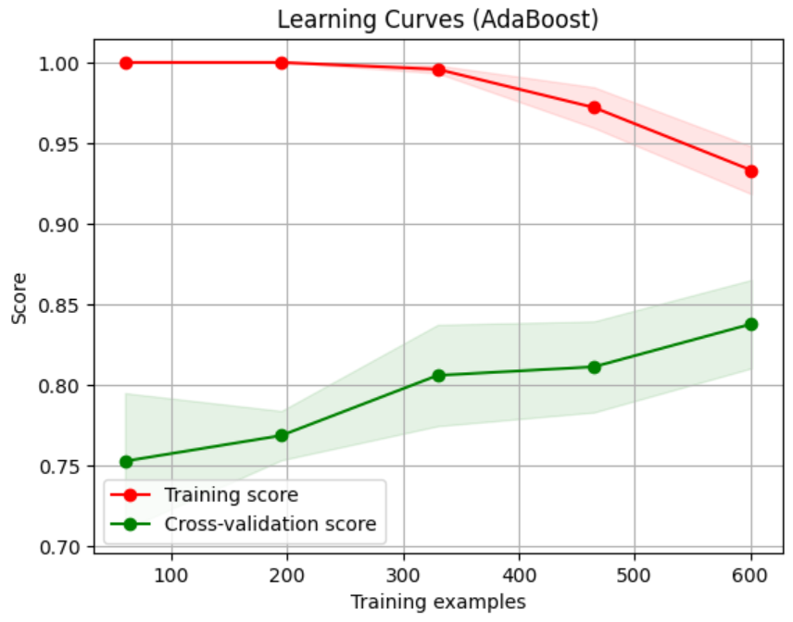
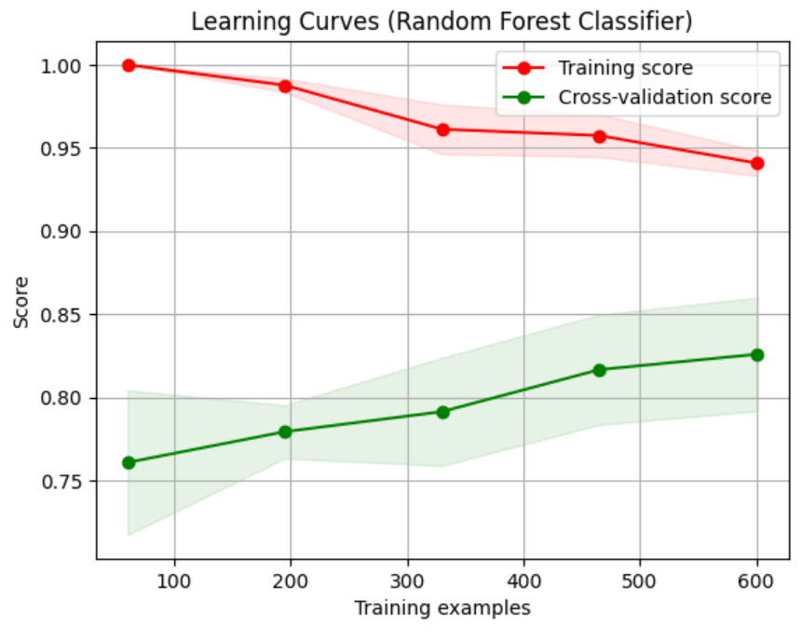
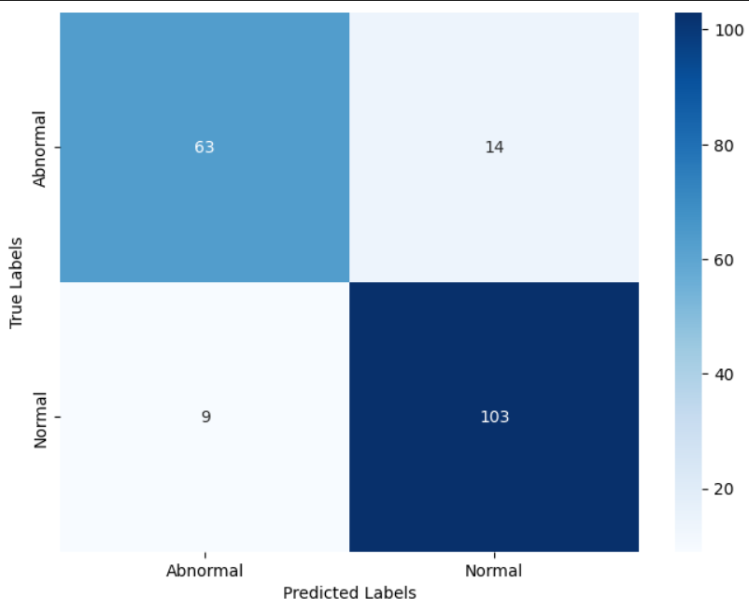
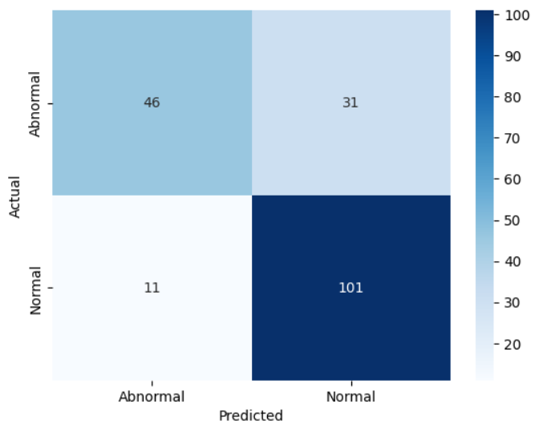
Result
We are getting 128 features from Mel spectrogram, 12 features from Chromagram, 40 features from MFCC and 1 feature from STFT.
Parameters before scaling and normalization:
STFT Features: mean: 0.3320191894084279, min: 0.0025506824156082343, max: 1.8567575058160326
MFCC Features: mean: -0.8170613065800402, min: -743.2326126010717, max: 172.68842933805306
Mel Spectrogram Features: mean: 6.783504110978435, min: 3.232929060754023e-08, max: 8305.237506372572
Chromagram Features: mean: 0.8142450129227182, min: 0.44248420547362244, max: 0.9888030561278763
Test Set Accuracy for AdaBoostClassifier: 84.66%
Test Set Accuracy for RandomForestClassifier: 87.83%
CNN Accuracy: 76.61%
Performance metrics of RandomForestClassifier Performance metrics of RandomForestClassifier

Slide 9

Conclusions
This work investigated a method for analyzing heart sounds to identify potential abnormalities. The approach utilizes various audio feature extraction techniques: STFT, MFCC, Mel Spectrogram, Chromagram.
Preprocessing ensured optimal model performance.
Benefits for automated heart sound abnormality detection include:
Improved efficiency for medical professionals.
Enhanced diagnostic accuracy through machine learning.
Future Work that can be done include:
Explore advanced models (deep learning) for accuracy gains.
Integrate this method into a user-friendly system for clinical applications.

Slide 10
References
Google Tensorflow blog for audio classification: https://www.tensorflow.org/tutorials/audio/simple_audio
Librosa:
https://librosa.org/doc/main/feature.html
ZCHSound: Open-Source ZJU Paediatric Heart Sound Database With Congenital Heart Disease:
IEEE Xplore Full-Text PDF:
Heart Sounds Classification Using Short-Time Fourier Transform and Gray Level Difference Method
https://www.researchgate.net/publication/362198732_Heart_Sounds_Classification_Using_Short-Time_Fourier_Transform_and_Gray_Level_Difference_Method

